Slide 2
.NET Core 3.0
Part 1
Janusz Marcinik · Software Developer · https://github.com/januszmarcinik

Slide 3
Agenda
Endpoints / Controllers
Request life cycle
Middleware
Logging | Serilog | SEQ

Slide 4
API Endpoints
Define GET / POST / PUT / DELETE http actions by single endpoints

Slide 5
A way to implement first endpoint
1
2
3
UseRouting
Adds route matching to the middleware pipeline.
It must come before any other route-aware middleware.
UseEndpoints
Adds endpoint execution to the middleware pipeline.
It runs the request delegate that serves the endpoint's response.
MapGet
Adds concret endpoint which can be handled by given route path and request delegate.

Slide 6
Startup.cs
public void Configure(IApplicationBuilder app, IWebHostEnvironment env)
{
app.UseRouting()
.UseEndpoints(endpoints =>
{
endpoints.MapGet("/api", async context =>
{
await context.Response.WriteAsync(
$"API is running on {env.EnvironmentName} environment");
});
});
}

Slide 7
Single endpoints as RESTful API? Let’s check it out!

Slide 8
API Controllers
Create a RESTful service with a set of facilities

Slide 9
public void ConfigureServices(IServiceCollection services)
{
services.AddControllers();
}
public void Configure(IApplicationBuilder app)
{
app.UseRouting()
.UseEndpoints(endpoints =>
{
endpoints.MapControllers();
});
}
Turn on controllers support

Slide 10
[Route("api/team-members")]
public class TeamMembersController : ControllerBase
{
private readonly ITeamMembersService _service;
public TeamMembersController(ITeamMembersService service)
{
_service = service;
}
[HttpPost]
public IActionResult Post([FromBody] TeamMember teamMember)
{
var id = _service.Add(teamMember);
_logger.LogInformation("Successfully created team member with id {ID}", id);
return Accepted($"Successfully created team member with id '{id}'.");
}
}
API Controller

Slide 11
The default for ASP.NET Core is now System.Text.Json, which is new in .NET Core 3.0.
Consider using System.Text.Json when possible.
It's high-performance and doesn't require an additional library dependency.
https://docs.microsoft.com

Slide 12
<PackageReference Include="Microsoft.AspNetCore.Mvc.NewtonsoftJson" Version="3.0.0" />
public void ConfigureServices(IServiceCollection services)
{
services.AddControllers()
.AddNewtonsoftJson(options =>
options.SerializerSettings.ContractResolver =
new CamelCasePropertyNamesContractResolver());
}
Switch to Newtonsoft.Json

Slide 13
Health checks
Check an app's status, thanks to health checks exposed by HTTP endpoints

Slide 14
public void ConfigureServices(IServiceCollection services)
{
services.AddHealthChecks();
}
public void Configure(IApplicationBuilder app)
{
app.UseRouting()
.UseEndpoints(endpoints =>
{
endpoints.MapHealthChecks("/health");
});
}
GET http://localhost:5000/health
HTTP/1.1 200 OK
Connection: close
Date: Tue, 18 Feb 2020 17:01:20 GMT
Content-Type: text/plain
Server: Kestrel
Cache-Control: no-store, no-cache
Pragma: no-cache
Transfer-Encoding: chunked
Expires: Thu, 01 Jan 1970 00:00:00 GMT
Healthy
Basic health check

Slide 15
internal class TeamMembersHealthCheck : IHealthCheck
{
private readonly ITeamMembersService _service;
public TeamMembersHealthCheck(ITeamMembersService service) =>
_service = service;
public Task<HealthCheckResult> CheckHealthAsync(
HealthCheckContext context, CancellationToken cancellationToken = new CancellationToken())
{
var isHealthy = _service.Any();
if (isHealthy)
{
return Task.FromResult(HealthCheckResult.Healthy("Team members exists"));
}
return Task.FromResult(HealthCheckResult.Unhealthy("There are no team members registered"));
}
}
TeamMembersHealthCheck.cs

Slide 16
public void ConfigureServices(IServiceCollection services)
{
services.AddHealthChecks()
.AddCheck<TeamMembersHealthCheck>(
"Team members health check");
}
GET http://localhost:5000/health
HTTP/1.1 503 Service Unavailable
Connection: close
Date: Tue, 18 Feb 2020 17:01:20 GMT
Content-Type: text/plain
Server: Kestrel
Cache-Control: no-store, no-cache
Pragma: no-cache
Transfer-Encoding: chunked
Expires: Thu, 01 Jan 1970 00:00:00 GMT
Unhealthy
[18:30:31 ERR] Health check Team members health check completed after 0.3627ms with status Unhealthy and 'There are no team members registered...'
Custom health check

Slide 17
Middleware
Define request pipeline

Slide 18
Middleware is software that's assembled into an app pipeline to handle requests and responses.
Middleware

Slide 19
Built-in middleware
Authentication
Provides authentication support.
Authorization
Provides authorization support.
CORS
Configures Cross-Origin Resource Sharing.
Cookie policy
Tracks consent from users for storing personal information.
Health check
Checks the health of an ASP.NET Core app and its dependencies.
OWIN
Interop with OWIN-based apps, servers, and middleware.
Session
Provides support for managing user sessions.
Static files
Provides support for serving static files and directory browsing.

Slide 20
Request life cycle
FIRST MIDDLEWARE
SECOND MIDDLEWARE
LAST MIDDLEWARE
// some logic
// more logic
// some logic
// more logic
// some logic
// more logic
REQUEST
next()
next()
Response

Slide 21
Use
Adds a middleware to the pipeline. The component’s code must decide whether to terminate or continue the pipeline. We can add as many Use methods as we want. They will be executed in the order in which they were added to the pipeline.
Middleware configuration
Use
UseWhen
app.Use(async (context, next) =>
{
LogInformation("Executing middleware...");
context.Request.Headers.Add("correlation-id", "{…}");
await next.Invoke();
LogInformation("Middleware executed.");
});
Map
MapWhen
Run

Slide 22
UseWhen
Extends Use configuration about condition specified in the predicate. Conditionally creates a branch in the pipeline that is rejoined to the main pipeline (unlike with MapWhen).
Middleware configuration
Use
UseWhen
app.UseWhen(context =>
context.Request.Path.Value.Contains("team-members"),
appBuilder =>
{
appBuilder.Use(async (context, next) =>
{
// middleware code
});
});
Map
MapWhen
Run

Slide 23
Map
Branches to appropriate middleware components, based on the incoming request's URL path.
Middleware configuration
app.Map("/api/branch", appBuilder =>
{
appBuilder.Use(async (context, next) =>
{
// middleware code
});
appBuilder
.UseRouting()
.UseEndpoints(endpoints =>
{
endpoints.MapControllers();
});
});
Use
UseWhen
Map
MapWhen
Run

Slide 24
MapWhen
Extends Map configuration about condition specified in the predicate.
Middleware configuration
Use
UseWhen
app.MapWhen(context =>
context.Request.Path.Value.Contains("api"), appBuilder =>
{
appBuilder.Use(async (context, next) =>
{
// middleware code
});
});
Map
MapWhen
Run

Slide 25
Run
These delegates don't receive a next parameter. The first Run delegate terminates the pipeline. Any middleware components added after Run will not be processed.
Middleware configuration
Use
app.MapWhen(context =>
context.Request.Path.Value.Contains("team-members"),
appBuilder =>
{
appBuilder.Run(async context =>
{
LogError("Endpoint 'team-members' is not allowed.");
await context.Response.WriteAsync("End of the request");
});
});
UseWhen
Map
MapWhen
Run

Slide 26
internal class ExceptionHandlerMiddleware
{
private readonly RequestDelegate _next;
public ExceptionHandlerMiddleware(RequestDelegate next)
{
_next = next;
}
public async Task InvokeAsync(HttpContext context)
{
try
{
await _next(context);
}
catch (Exception ex)
{
LogError(ex, ex.Message);
context.Response.StatusCode = (int)HttpStatusCode.InternalServerError;
await context.Response.WriteAsync(ex.Message);
}
}
}
Middleware in a class

Slide 27
Logging
Configure logger and manage your logs

Slide 28
Usage
public class TeamMembersController : ControllerBase
{
private readonly ILogger _logger;
public TeamMembersController(ILogger<TeamMembersController> logger)
{
_logger = logger;
}
public IActionResult GetById(Guid id)
{
var teamMember = _service.GetById(id);
if (teamMember == null)
{
_logger.LogError("Team member with given id {ID} does not exist", id);
return NotFound($"Team member with given id '{id}' does not exist.");
}
return Ok(teamMember);
}
}

Slide 29
info: Microsoft.AspNetCore.Routing.EndpointMiddleware[1] Executed endpoint 'Health checks' info: Microsoft.AspNetCore.Hosting.Diagnostics[2] Request finished in 76.11070000000001ms 200 text/plain info: Microsoft.AspNetCore.Hosting.Diagnostics[1] Request starting HTTP/1.1 GET http://localhost:5000/api/team-members application/json fail: NETCore3.Startup[0] Endpoint 'team-members' is not allowed while using branched middleware pipeline. info: Microsoft.AspNetCore.Hosting.Diagnostics[2] Request finished in 6.301200000000001ms 200 info: Microsoft.AspNetCore.Hosting.Diagnostics[1] Request starting HTTP/1.1 GET http://localhost:5000/api/role/frontend info: Microsoft.AspNetCore.Routing.EndpointMiddleware[0] Executing endpoint 'NETCore3.Controllers.FrontendController.Get (NETCore3)' info: Microsoft.AspNetCore.Mvc.Infrastructure.ControllerActionInvoker[3] Route matched with {action = "Get", controller = "Frontend"}. Executing controller action with signature Microsoft.AspNetCore.Mvc.IActionResult Get() on controlle r NETCore3.Controllers.FrontendController (NETCore3).
Default console output

Slide 30

Serilog completely replaces the logging implementation on .NET Core: it’s not just a provider that works side-by-side with the built-in logging, but rather, an alternative implementation of the .NET Core logging APIs.
Serilog

Slide 31
Program.cs
public static void Main(string[] args)
{
Log.Logger = new LoggerConfiguration()
.Enrich.FromLogContext()
.WriteTo.Console()
.WriteTo.Seq("http://localhost:5341")
.CreateLogger();
try
{
Log.Information("Starting up");
CreateHostBuilder(args).Build().Run();
}
catch (Exception ex)
{
Log.Fatal(ex, "Host builder error");
}
finally
{
Log.CloseAndFlush();
}
}

Slide 32

Program.cs
public static IHostBuilder CreateHostBuilder(string[] args) =>
Host.CreateDefaultBuilder(args)
.UseSerilog()
.ConfigureLogging(logging =>
{
logging.ClearProviders();
logging.AddConsole();
});
Startup.cs
public void Configure(IApplicationBuilder app)
{
app.UseSerilogRequestLogging();
}

Slide 33
[21:22:26 ERR] Endpoint 'team-members' is not allowed while using branched middleware pipeline. [21:22:26 INF] HTTP GET /api/team-members responded 200 in 1.4184 ms [21:22:26 INF] Request finished in 6.7854ms 200 [21:22:27 INF] Request starting HTTP/1.1 GET http://localhost:5000/health [21:22:27 WRN] Any branched route has not been mapped. [21:22:27 INF] Executing endpoint 'Health checks' [21:22:27 INF] Executed endpoint 'Health checks' [21:22:27 INF] HTTP GET /health responded 200 in 9.7714 ms [21:22:27 INF] Request finished in 18.262700000000002ms 200 text/plain [21:22:28 INF] Request starting HTTP/1.1 GET http://localhost:5000/health [21:22:28 WRN] Any branched route has not been mapped. [21:22:28 INF] Executing endpoint 'Health checks' [21:22:28 INF] Executed endpoint 'Health checks' [21:22:28 INF] HTTP GET /health responded 200 in 6.8392 ms [21:22:28 INF] Request finished in 14.2779ms 200 text/plain [21:22:29 INF] Request starting HTTP/1.1 GET http://localhost:5000/api/team-members application/json [21:22:29 ERR] Endpoint 'team-members' is not allowed while using branched middleware pipeline. [21:22:29 INF] HTTP GET /api/team-members responded 200 in 1.9388 ms [21:22:29 INF] Request finished in 10.090300000000001ms 200
Serilog console output

Slide 34
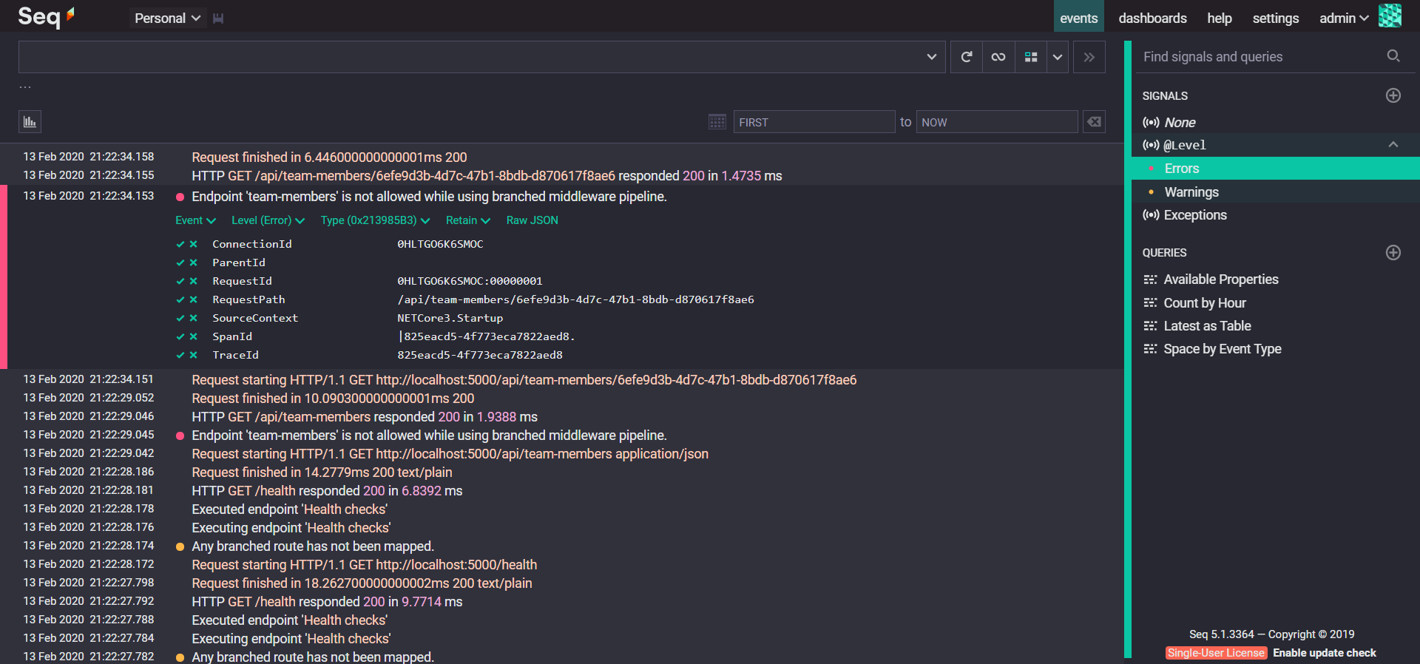

Slide 35
Seq creates the visibility you need to quickly identify and diagnose problems in complex applications and microservices.
https://datalust.co/seq

Slide 36
Quick start with Seq
1
2
3
Install Seq
The Seq server can be installed on windows or started from linux-based docker image.
Connect logger
In Serilog, there is only one additional configuration line that adds a sink to Seq according to the given ULR.
Open in browser
Open Seq in browser to see logs. By default it starts on http://localhost:5341.

Slide 38
Thank you!
Go visit pgs-soft.com
https://github.com/januszmarcinik

